Slide 1
UK Railway Performance Dashboard
DEPI Graduation Project | Data Analysis & Power BI Specialist Track
Supervised by: Dr/ Bassam El-Shoraa

Slide 2
Team Members
01
02
03
05
Amr Ahmed Farouk
Salma Ibrahim Omair
Malak Wael Abdelaziz
Data Preparation & Cleaning Lead
Data Modeling Lead & Presentation
DAX & Measures Lead
04
Mahmoud Ahmed Mahmoud
06
Rahma Osama Mohamed
Alaa Mohamed Sayed
Visuals & Dashboard Lead
Testing, QA & Documentation Lead
Presentation & Reporting Lead

Slide 3
Table of Contents
Project Overview
01
02
Dataset Description
03
Data Modeling
Train
04
DAX Measures
05
Key Insights

Slide 4
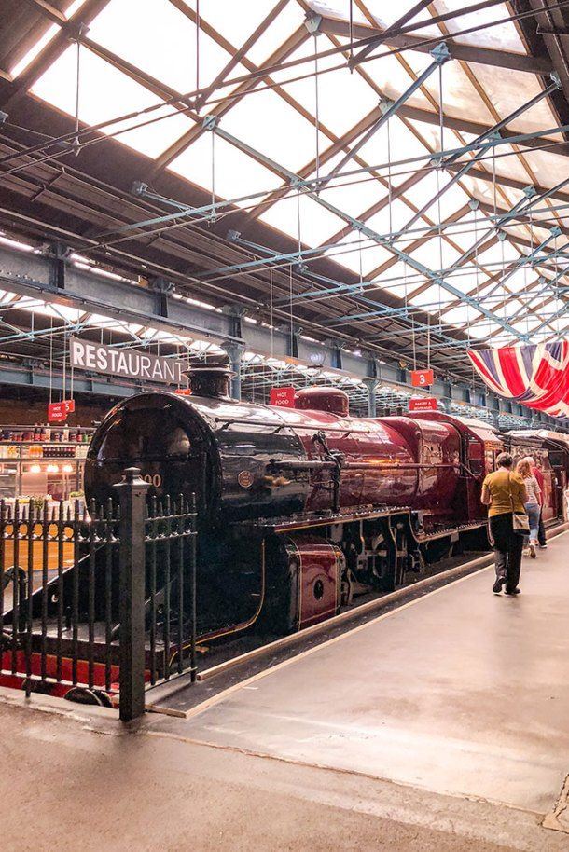
Project Overview
01

Slide 5
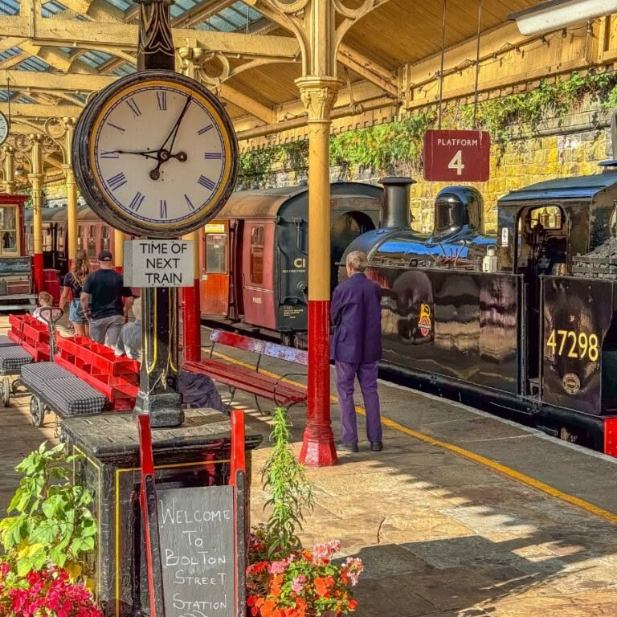
Overview
This project is an interactive UK Railway Analytics Dashboard built using Microsoft Power BI. It analyzes ticket sales performance, journey punctuality, delay patterns, and refund behavior across 31,653 real transaction records from December 2023 to April 2024.
The dashboard helps railway operations teams make data-driven decisions through 9 interactive pages covering revenue, regional performance, customer behavior, and time trends.
3 highlight stats:
31,653 Transactions
£741.92K Total Revenue
9 Dashboard Pages

Slide 6
02
Dataset Description

Slide 7
Contents of the Dataset
The dataset consists of one file: railway.csv
Fields inside the file:
Transaction ID - Unique identifier for an individual train ticket purchase
Date of Purchase - Date the ticket was purchased
Time of Purchase - Time the ticket was purchased
Purchase Type - Whether the ticket was purchased online or directly at a train station
Payment Method - Payment method used to purchase the ticket (Contactless, Credit Card, or Debit Card)
Railcard - Whether the passenger is a National Railcard holder (Adult, Senior, or Disabled) or not (None)
Ticket Class - Seat class for the ticket (Standard or First)
Ticket Type - When you bought or can use the ticket (Advance, Off-Peak, Anytime)
Price - Final cost of the ticket
Departure Station - Station to board the train
Arrival Destination - Station to exit the train
Date of Journey - Date the train departed
Departure Time - Time the train departed
Arrival Time - Time the train was scheduled to arrive at its destination (can be on the day after departure)
Actual Arrival Time - Time the train arrived at its destination (can be on the day after departure)
Journey Status - Whether the train was on time, delayed, or cancelled
Reason for Delay - Reason for the delay or cancellation
Refund Request - Whether the passenger requested a refund after a delay or cancellation

Slide 8
Problems found & fixed:
Duplicate values
Inconsistent labels
Null Delay Reason
Type errors

Slide 9
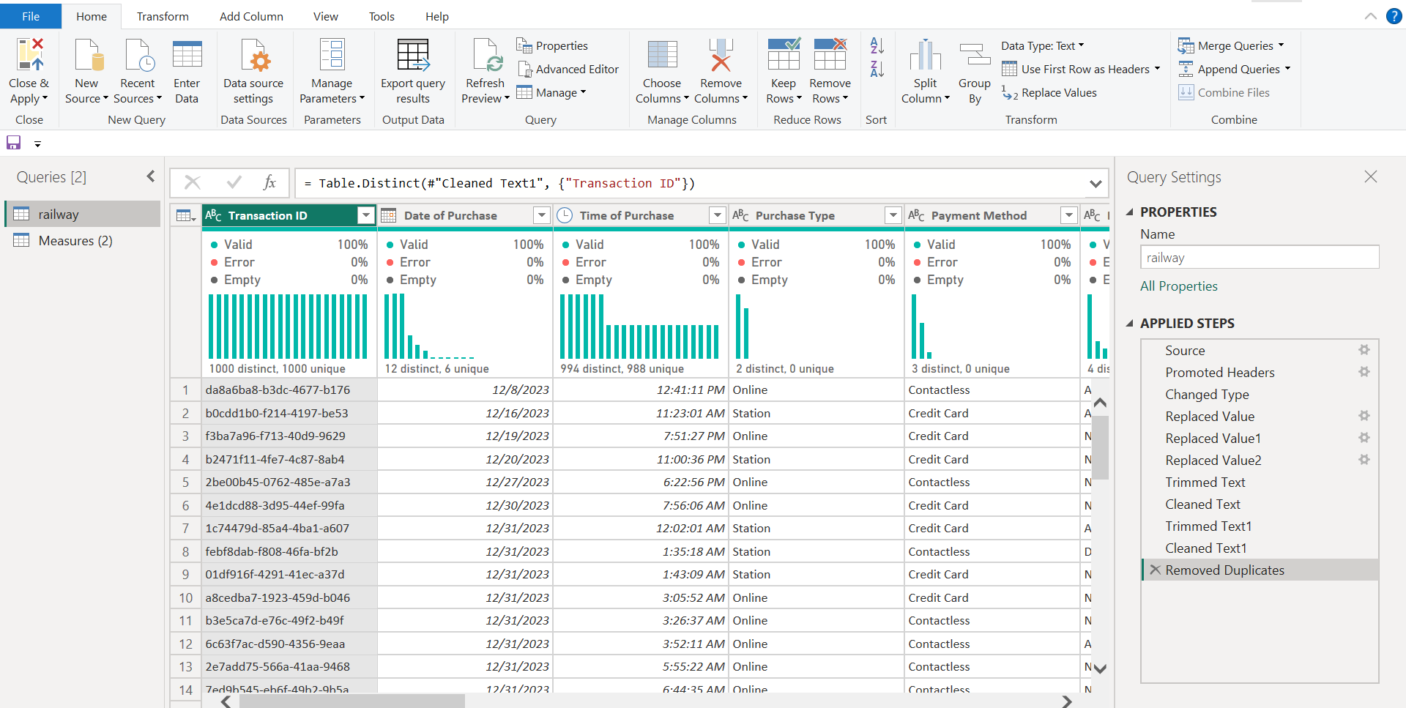
Data Cleaning

Slide 10
Data Modeling
03

Slide 11
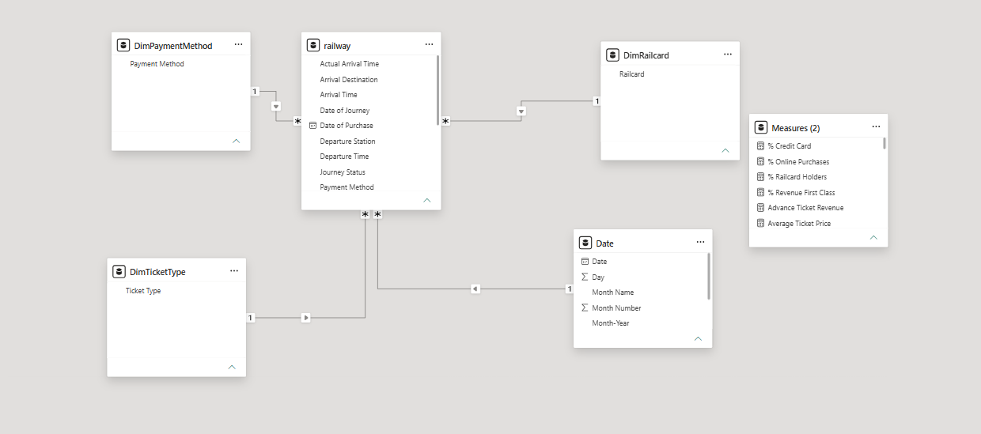
Star Schema

Slide 12
Railway Fact Table
Columns:
Transaction ID
Date of Purchase
Time of Purchase
Purchase Type
Payment Method
Ticket Class
Ticket Type
Price
Railcard
Departure Station
Arrival Destination
Date of Journey
Departure Time
Arrival Time
Actual Arrival Time
Journey Status
Reason for Delay
Refund Request

Slide 13
Dimensions
DimPaymentMethod:
Payment Method
DimRailcard:
Railcard
Date:
Date
Day
Month Name
Month Number
Month-Year
Quarter
Weekday
Year
DimTicketType:
Ticket Type

Slide 14
Calculated Columns
Column | Logic
Journey Duration (min) | Actual Arrival Time – Departure Time
Delay Minutes | Actual Arrival Time – Arrival Time (when Delayed)
Route | Departure Station & " → " & Arrival Destination
Purchase Lead Days | Date of Journey – Date of Purchase

Slide 15
DAX Measures
04

Slide 16
Key DAX Measures
Measure | Formula
Total Revenue | SUM(railway[Price])
Total Journeys | COUNTROWS(railway)
On-Time Rate | DIVIDE([On-Time Journeys], [Total Journeys], 0)
Cancellation Rate | DIVIDE([Cancelled Journeys], [Total Journeys], 0)
% Credit Card | DIVIDE([Credit Card Payments], COUNTROWS(railway))
Advance Ticket Revenue | CALCULATE(SUM(railway[Price]), railway[Ticket Type]="Advance")
Lowest Month Revenue | CALCULATE(MINX(VALUES('Date'[Month-Year]), [Monthly Revenue]))
% Revenue First Class | DIVIDE([First Class Revenue], [Total Revenue])

Slide 17
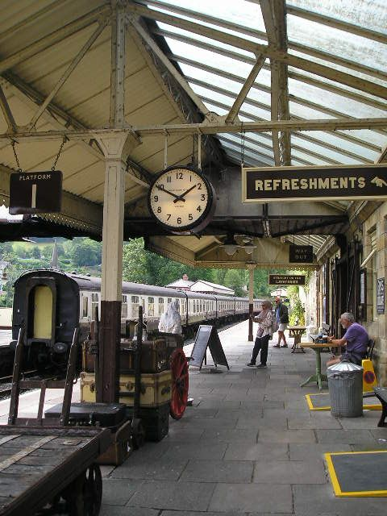
Key KPIs
05

Slide 18
KPIs Categories
Sales & Revenue:
Operational Performance
Total Revenue
Total Journeys
Advance Ticket Revenue
On-Time Rate
Advance Ticket Revenue
Cancellation Rate
First Class Revenue
Refund Rate
Avg Monthly Revenue
Total Passengers
Lowest Month Revenue
% Online Purchases
% Credit Card

Slide 19
Charts Categories
Sales & Revenue:
Operational Performance:
Revenue by Ticket Type
Ticket Class Revenue Split
Avg Ticket Price by Ticket Type
Railcard Holder Distribution
Monthly Revenue vs Trip Volume
Purchase Channel Trends
Payment Method Split
Monthly Refund Trend
Journey Status Breakdown
Delay & Disruption Causes
On-Time Rate by Departure Station
Monthly Disruptions
Monthly On-Time Rate Trend
Station Revenue Map
Route Performance Table
Payment Method by Purchase Channel
Railcard Distribution by Purchase Channel

Slide 20
Data Insights
Table of Contents:
Revenue & Ticket Type Performance
Journey Status & Delay Analysis
Regional & Station Performance
Customer & Payment Behavior

Slide 21
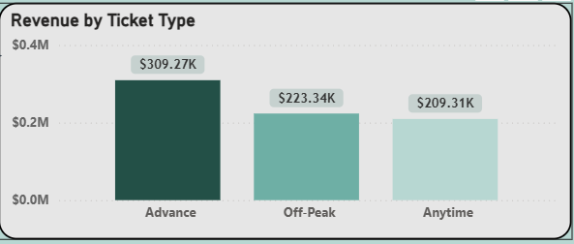


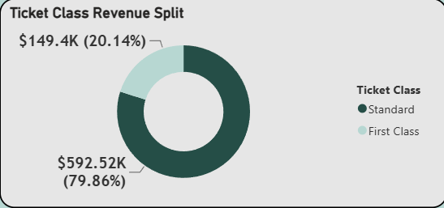

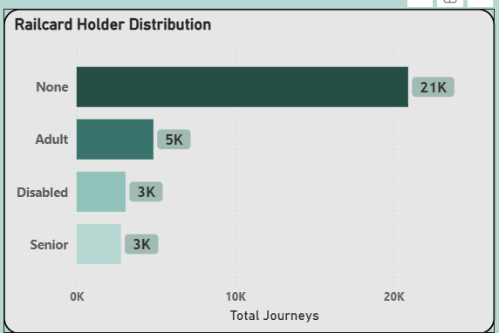
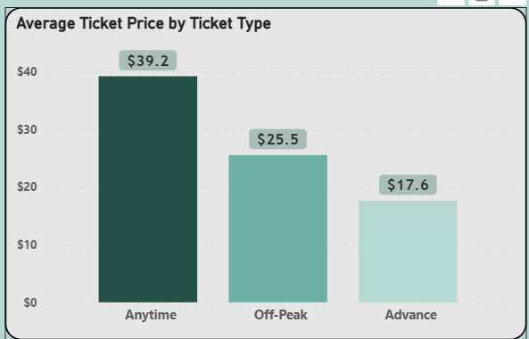
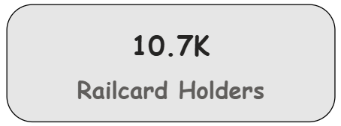
Data Insights
Revenue & Ticket Type Performance

Slide 22

Data Insights
Revenue & Ticket Type Performance
Exploration:
Total Revenue: $741.92K
Advance tickets generate the highest revenue: $309.27K (41.7%)
Standard Class dominates: $592.52K (79.86%) vs First Class: $149.4K (20.14%)
Anytime tickets have the highest avg price: $39.2
Off-Peak: $25.5 | Advance: $17.6 (cheapest)
10.7K passengers hold a Railcard

Slide 23

Data Insights
Revenue & Ticket Type Performance
Exploration: Advance tickets generate the most revenue despite being the cheapest, due to high volume of sales. Anytime tickets are the most expensive but least purchased.
Suggested Explanation: Passengers prefer to book in advance to get cheaper prices. Standard Class dominates revenue as it's more accessible and affordable compared to First Class.

Slide 24
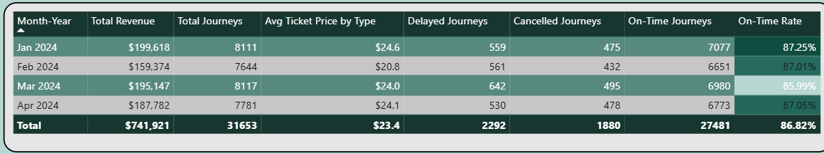
Data Insights
Journey Status & Delay Analysis

Slide 25
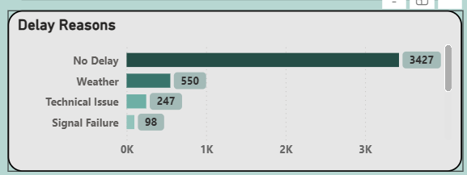
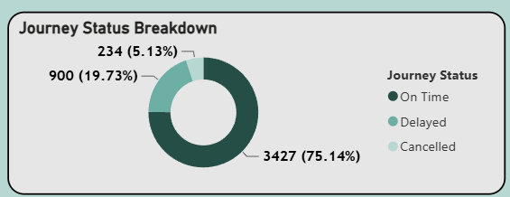
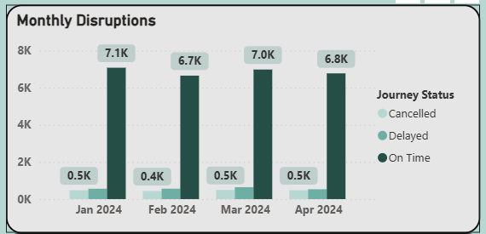
Data Insights
Journey Status & Delay Analysis

Slide 26
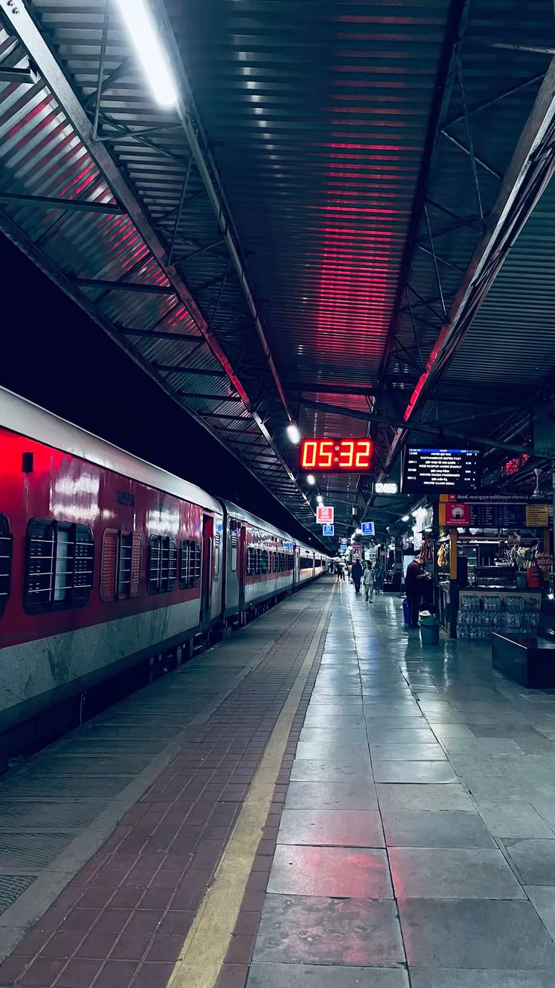
Data Insights
Journey Status & Delay Analysis
Exploration:
On-Time Journeys: 27,481 (86.82%)
Delayed Journeys: 2,292 (7.24%)
Cancelled Journeys: 1,880 (5.94%)
Peak month for delays: March 2024 (642 delayed journeys)
Top delay causes: Weather (995), Signal Failure (970), Technical Issue (707)

Slide 27
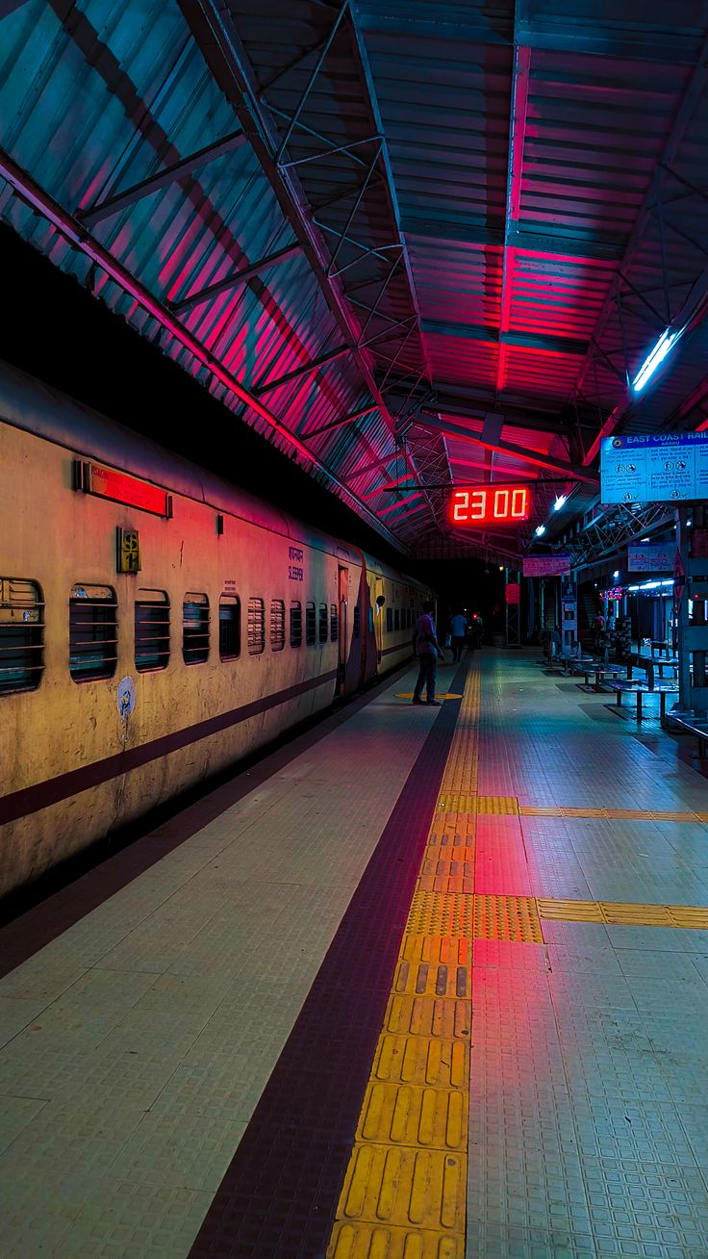
Data Insights
Journey Status & Delay Analysis
Exploration: The highest number of delayed journeys happens in March 2024 at 642 delays, and the main causes are Weather, Signal Failure, and Technical Issues.
Suggested Explanation: Some stations suffer from staff shortage, others from weather conditions and others from technical issues. This leads to delays which most likely affects the highest demand routes like London Kings Cross → York.

Slide 28




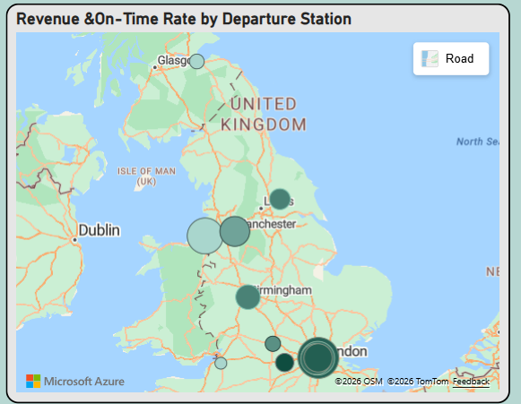
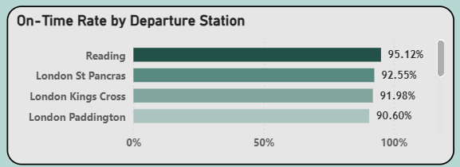
Data Insights
Regional & Station Performance

Slide 29
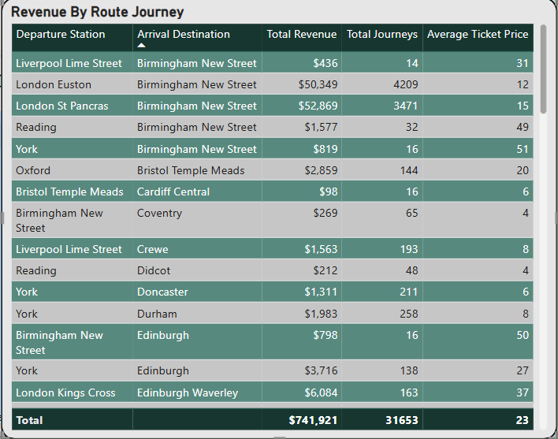
Data Insights
Regional & Station Performance

Slide 30

Data Insights
Regional & Station Performance
Exploration:
Best On-Time Station: Reading (95.12%)
Worst On-Time Station: Liverpool Lime Street (75.14%)
Top Departure Station by Revenue: London Kings Cross ($183,193)
Most Trips Station: Manchester Piccadilly
Top route: London Kings Cross → York (3,922 journeys)
Suggested Explanation: High demand routes like London Kings Cross → York generate the most revenue due to high trip volume. Stations with staff shortage and technical issues like Liverpool Lime Street suffer from lower punctuality rates.

Slide 31




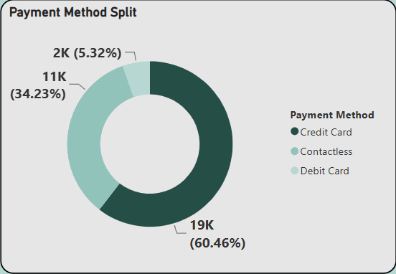
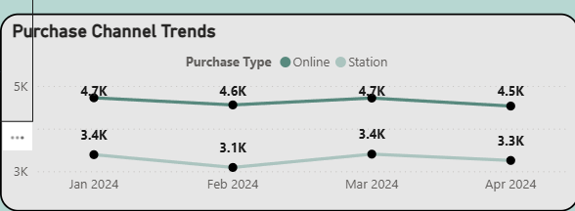
Data Insights
Customer & Payment Behavior

Slide 32
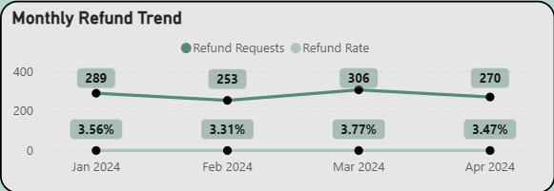
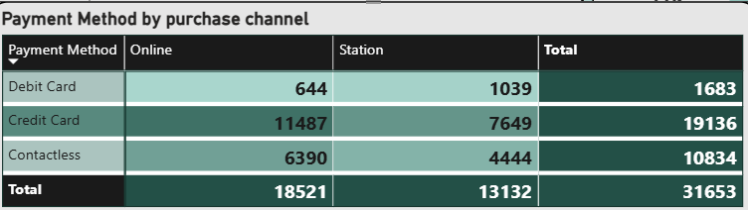
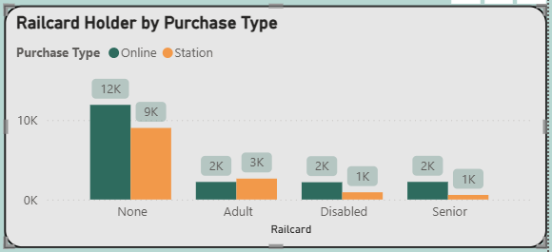
Data Insights
Customer & Payment Behavior

Slide 33

Data Insights
Customer & Payment Behavior
Exploration:
58.51% of purchases are made Online vs 41.49% at Station
Credit Card is the dominant payment method: 60.46%
Refund Rate is consistent across months: ~3.3% – 3.77%
Disabled & Senior railcard holders prefer to purchase Online
Adult railcard holders more likely to purchase at Station
Suggested Explanation: Disabled and Senior passengers prefer online purchasing as they cannot wait in long queues at stations. Credit Card dominates as it's the most convenient payment method for both online and station purchases.

Slide 34
Unavailable KPIs
Financial & Efficiency Metrics:
Revenue per Passenger-Kilometer
Operating Cost per Kilometer
Energy Efficiency per Journey
Infrastructure & Utilization:
Seat Occupancy Rate
Platform Utilization per Station
Turnaround Time at Stations
Peak vs. Off-Peak Utilization Rate
Customer Satisfaction & Service Quality:
Customer Satisfaction Score (CSAT)
Customer Retention Rate
Net Promoter Score (NPS)

Slide 35
Thanks!
UK Railway Performance Dashboard | DEPI Graduation Project

